Slide 1
Models and the UML
TP-01b · Why we model, visual notations and the Unified Modeling Language
Análise de Sistemas (ASis)
Licenciatura em Engenharia de Computadores e Informática
Ilídio Oliveira · ico@ua.pt
2026/2027

Slide 2
Learning objectives
Justify the use of models in engineering and in software
Explain the value of visual models and of a shared notation
Describe the origin and the organisation of the UML
Recognise the main UML diagrams and the perspective each one covers
Critically assess models produced with generative AI

Slide 3
Why engineers build models
01
Reasoning about a system before building it

Slide 4
Every engineering discipline models first
Civil engineering
Architectural plans, structural calculations, scale models
Electronics
Schematics, circuit simulation, PCB layouts
Aeronautics
Aerodynamic simulations, wind-tunnel models
Software engineering
Requirements, UML diagrams, specifications
Why? Because it is cheaper and safer to reason about a model than about the real thing.
Manage complexity: look at one concern at a time and hide the rest.
Find problems early: a wrong requirement costs less on paper than in production.
Communicate: give every stakeholder the same picture of the system.

Slide 5
What is a model?
A model is a partial and abstract representation of a system, built for a purpose. It keeps what matters for that purpose and leaves out the rest.
01 Visualise
the system as it is or as we want it to be — and share that vision with the team
02 Specify
the structure and behaviour of the system before coding it
03 Construct
with a blueprint that guides implementation — a plan of action for developers
04 Document
the decisions taken, without relying on anyone's memory
The four aims of modelling, after Booch, Rumbaugh & Jacobson, The Unified Modeling Language User Guide (2nd ed., 2005).

Slide 6
Visual models support the whole lifecycle
Activity | What models help to do | Typical UML diagrams
Requirements | Capture goals, actors and scenarios; agree scope with stakeholders | Use case, activity
Analysis | Understand the domain concepts and the business processes | Class (domain model), activity, state machine
Design | Decide the architecture and how parts collaborate | Component, sequence, class, deployment
Implementation | Guide construction — by people or by AI agents | Class, sequence, package
Operation and evolution | Explain the system to newcomers; assess the impact of change | Deployment, component
Table 1 – Diagrams can be used in several activities; the mapping shows typical use, not a rule.
Notes:
Larman (Applying UML and Patterns) stresses that visual modelling exploits our ability to grasp symbols and relationships in 2D box-and-line notations, helping us see the big picture while hiding uninteresting detail.

Slide 7
The value of visual models
02
A shared notation, read and written by everyone

Slide 8
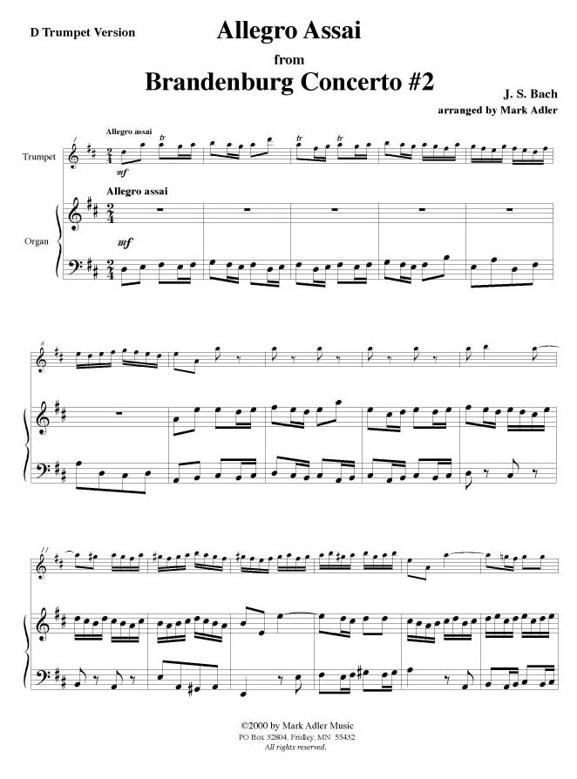
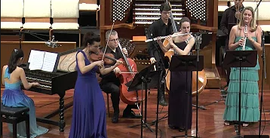
A music score is a model
Music domain | Software Eng. domain
Standard notation that any trained musician can read | UML: a notation every team member can read and write
The composer designs the piece before it is played | Analysts and architects design before the system is built
One part per instrument, all consistent with the score | One diagram per concern, all consistent with the model
Composing needs talent and technical discipline | Modelling needs domain insight and engineering discipline
The orchestra performs: proof that the score works | The running system — or the agent's implementation — validates the model
Notes:
Score: J. S. Bach, Brandenburg Concerto No. 2 (Allegro assai), arrangement for trumpet and organ. The score is not the music, just as the model is not the system — but it lets many people produce the same result, predictably.

Slide 9
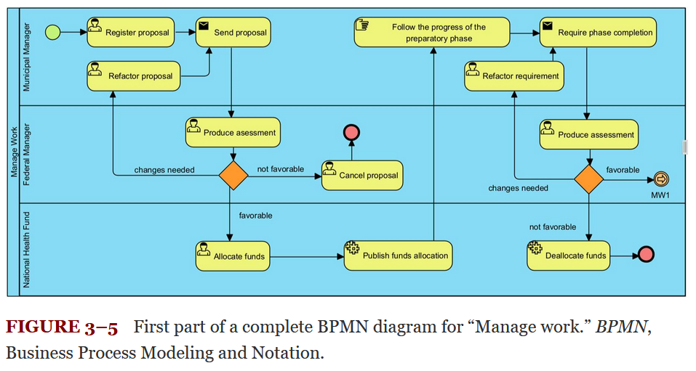
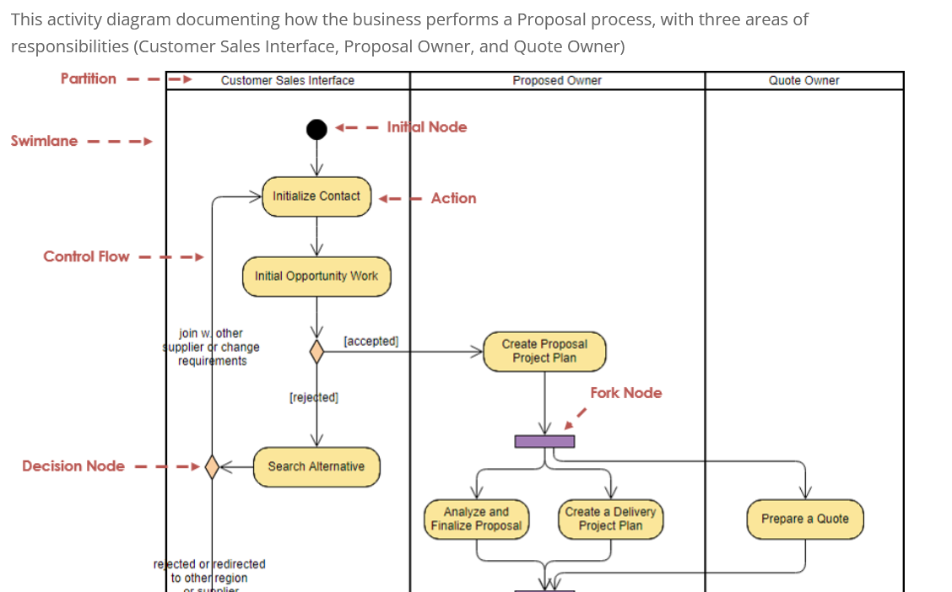
Same process, two visual notations
BPMN — business view of a proposal process, with pools and lanes.
UML activity diagram — partitions, actions, decisions and forks.
A visual notation lets us read the flow at a glance — as long as everyone knows the notation.
Notes:
[TO CONFIRM] Add the full source references for both figures (the BPMN figure is "Figure 3-5, Manage work").

Slide 10
Why a uniform notation matters
Four methods, four notations
Development happens in multidisciplinary, often distributed teams
Models must be understood by everyone: clients, analysts, developers, testers — and now AI agents
In the early 1990s, each object-oriented method had its own notation
The answer: the Unified Modeling Language (UML) — one notation, usable with many methods
Booch
OMT
OOSE
Fusion
UML
one notation

Slide 11
The origin of the UML
03
From the "method wars" to an OMG standard

Slide 12



The "Three Amigos"
Ivar Jacobson
OOSE / Objectory
Thinking in use cases
Grady Booch
Booch method
Thinking in object-oriented design
James Rumbaugh
OMT
Thinking in class (object) modelling
They joined forces at Rational Software (1994–1995) and unified the semantics and notation of their methods, so that users could focus on their work rather than on the specifics of a given method.

Slide 13
From unification to standard
Early 1990s
1994
1995
1997
2005
2012
2017
Dozens of competing OO methods and notations ("method wars")
Booch and Rumbaugh start the unification at Rational
Jacobson joins; Unified Method 0.8 draft (October)
UML 1.1 adopted by the Object Management Group (OMG)
UML 2.0: major revision of the language
UML 2.4.1 published as ISO/IEC 19505
UML 2.5.1 — the current OMG version
Today: UML is maintained by the OMG. It is a notation, not a method — you choose the process (e.g., OpenUP) and the diagrams that are worth drawing.
Sources: OMG UML specification version history (omg.org/spec/UML); Booch, Rumbaugh & Jacobson (2005).
Notes:
UML 1.4.2 was also published as ISO/IEC 19501:2005. OMG formal versions: 1.1 (1997), 1.3 (2000), 1.4 (2001), 1.5 (2003), 2.0 (2005), 2.1.2 (2007), 2.2 (2009), 2.3 (2010), 2.4.1 (2011), 2.5.1 (2017).

Slide 14
UML perspectives and diagrams
04
Structure, behaviour and interaction

Slide 15
The UML 2.5 diagrams
UML diagram
Structural diagrams
Behavioural diagrams
Class
Object
Use case
Interaction diagrams
Structural: the static organisation of the system — its parts and their relationships.
Behavioural: the dynamic behaviour — how parts interact and collaborate over time to deliver functionality.
Sequence
Package
Component
Activity
Communication
Composite structure
Deployment
State machine
Timing
Profile
Interaction overview
Figure 1 – The 14 diagram types of UML 2.5.1 (7 structural, 7 behavioural, 4 of which are interaction diagrams).

Slide 16
Which diagram answers which question?
Perspective | Question | Diagrams | Mainly in
Usage | Who uses the system, and for what? | Use case | Analysis
Process | How does the work flow? | Activity | Analysis, design
Domain / structure | Which concepts exist and how do they relate? | Class, object, package | Analysis, design
Interaction | Which parts collaborate, in which order? | Sequence, communication | Design
Life cycle of an entity | Which states can an object be in? | State machine | Analysis, design
Architecture | Which components exist and where do they run? | Component, deployment | Design, implementation
Table 2 – A pragmatic selection. You rarely need all 14 diagrams: draw the ones that answer a real question.

Slide 17
How much UML? Three ways to use it
UML as sketch
Informal, selective diagrams to think and communicate. Most common in practice.
UML as blueprint
Detailed, complete models that others (or tools, or agents) build from.
UML as programming language
Executable models and full code generation (model-driven engineering).
In ASis: mostly sketch and blueprint — models precise enough to be discussed with stakeholders and used as input to specifications (OpenSpec) and AI agents.
Classification after M. Fowler, UML Distilled (3rd ed., 2004).

Slide 18
Generative AI and modelling
05
Useful assistant, unreliable author

Slide 19
What generative AI can/can not do with models
Useful for
Drafting candidate concepts from a text description
Producing text-based diagrams (PlantUML, Mermaid)
Explaining an existing diagram in plain language
Suggesting missing elements, alternatives and questions to ask
Checking a model against a list of requirements
Advanced: MCP connection to tools such as VisualParadigm
Getting better by the month!
Evidence (for now…): ChatGPT and UML
Syntactic and semantic deficiencies in the class models produced
Inconsistent answers to the same request
Does not work well above 8–10 classes generated from scratch
Better results in well-documented domains (e.g., banking) than in unusual ones
The effort needed to reach a correct model is not negligible
Cámara, Troya, Burgueño & Vallecillo (2023). On the assessment of generative AI in modeling tasks: an experience report with ChatGPT and UML. Software and Systems Modeling (2023).
Notes:
Newer models perform better, but the MODELS/SoSyM literature (e.g., Chen et al., MODELS 2023; Ben Chaaben et al., 2024) still points to human-in-the-loop assistance rather than full automation.

Slide 20

Pitfalls of AI-generated models
01
Plausible but wrong
Wrong multiplicities, duplicated aggregations, associations with the wrong direction
02
Invented requirements
Elements that no stakeholder asked for — or missing rules that only your organisation knows
03
Inconsistency
Different answers to the same prompt; diagrams that contradict each other
04
Notation drift
Non-UML symbols, mixed notations, PlantUML/Mermaid that does not render
05
Generic by default
The textbook version of the domain instead of your client's reality
06
Skipping the thinking
The main value of modelling is the understanding you build while doing it

Slide 21
Using generative AI responsibly when modelling
You elicit
Requirements come from stakeholders, not from the model
AI drafts
A first proposal, as text (PlantUML/Mermaid)
You review
Against requirements and UML rules
Stakeholders validate
Walk through the model with them
Version it
Keep the model in Git with the specs
Review checklist
Every element traces back to a requirement or a stakeholder statement
Multiplicities, association directions and aggregations are justified
The notation is valid UML and the diagrams are consistent with each other
You can explain every element without the AI — you are accountable for it
AI use is declared, as required by the course rules and the UA framework

Slide 22
Next: activity diagrams
Show a flow of actions — from a business process (high level) to a single algorithm (low level)
Use them to model workflows, compare the as-is and to-be process, or visualise a complex algorithm
Not a flowchart, but built on the same idea: a graph of the flow of actions
Read: Miles & Hamilton, Learning UML 2.0, chapter 3

Slide 23
References
Booch, G., Rumbaugh, J. & Jacobson, I. (2005). The Unified Modeling Language User Guide (2nd ed.). Addison-Wesley.
Fowler, M. (2004). UML Distilled (3rd ed.). Addison-Wesley.
Larman, C. (2004). Applying UML and Patterns (3rd ed.). Prentice Hall.
Miles, R. & Hamilton, K. (2006). Learning UML 2.0. O'Reilly.
Object Management Group (2017). Unified Modeling Language, version 2.5.1. omg.org/spec/UML
Cámara, J., Troya, J., Burgueño, L. & Vallecillo, A. (2023). On the assessment of generative AI in modeling tasks. Software and Systems Modeling.
Chen, K. et al. (2023). Automated domain modeling with large language models: a comparative study. MODELS 2023.

